Slide 1
Vocabulary
IFL unit
Bone Black

Slide 2
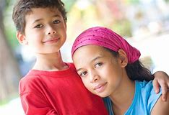
devotion
Like twins they shared the same dreams and longings, the same devotion to one another.
Love, loyalty, or enthusiasm for a person, activity, or cause.

Slide 3
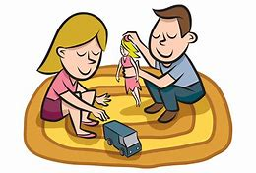
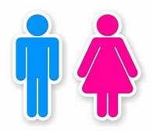
roles
Strangely enough it was a toy that separated them, that forced upon them different roles, different identities.
The part played by a person in a particular situation.

Slide 4
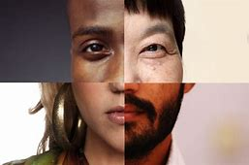
identities
Strangely enough it was a toy that separated them, that forced upon them different roles, different identities.
What a person or thing is.

Slide 5
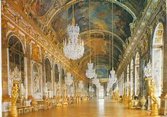
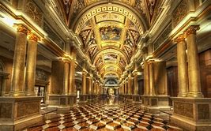
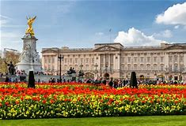
splendor
She was to ride in it because she was a girl – a would-be princess whom some rich prince would come seeking, take away to his palace, and keep her there in splendor forever.
Magnificent and splendid appearance; grandeur.

Slide 6
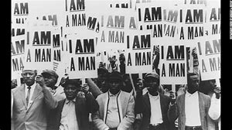
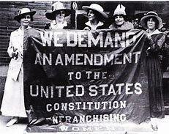
assert
It was because of this that she began to assert her girl rights, to tell him that he was the boy and should pull her.
To cause others to recognize one’s right by confident or forceful behavior.

Slide 7
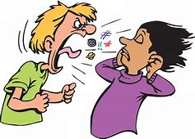
harsh
They would stand towering over him speaking in harsh big voices, explaining that he was the boy and should do this...
Cruel or severe.

Slide 8
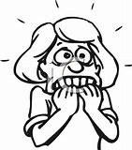
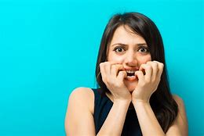
apprehensive
She looks apprehensive, unsure.
Anxious or fearful that something bad will happen.

Slide 9
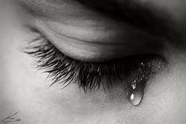
sorrow
She could understand the boy’s pleasure, his longing, his constant sorrow.
A feeling of deep sadness caused by loss or disappointment.

