Slide 1
Animal Farm Week 4
7th Grade Language Arts

Slide 2
Bell Ringers
Monday: What is narrative writing?
Example?

Slide 3
Narrative Writing Quiz
What point of view are all narratives told from?
What is figurative language?
What are different types of figurative language?
What are sensory details?
What are the different parts of plot?

Slide 4
1. Narratives Always 1st person Example: My balloon dragged me up to the moon

Slide 5
2. The trees danced in the wind

Slide 6
3. Types of Figurative Language

Slide 7
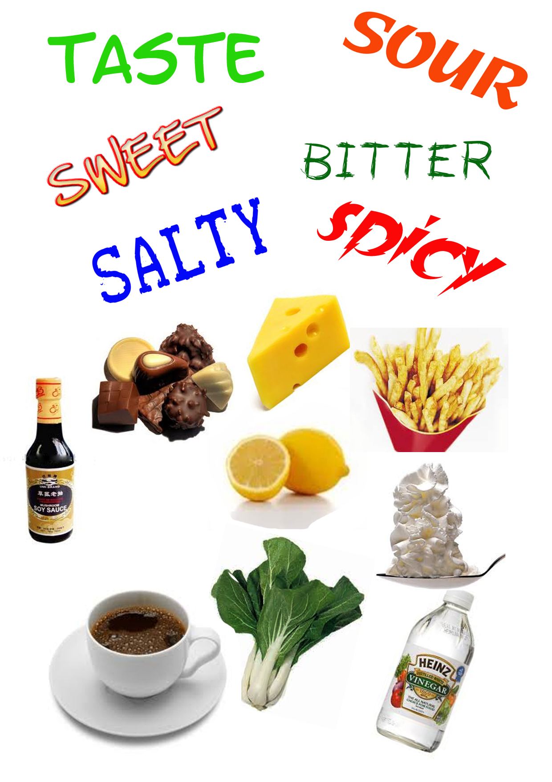
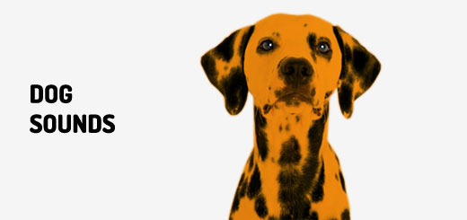
4. Sensory Details

Slide 8
5. Plot structure
This Photo by Unknown Author is licensed under CC BY-ND

Slide 9
Part 2
Maxwell struggles with his insecurity and academic achievement
Kevin struggles with his illness
Snowball and Napoleon cant seem to get along
All the animals revolt and drive Mr. Jones off the farm

Slide 10
Part 2: Answers
Maxwell struggles with his insecurity and academic achievement C
Kevin struggles with his illness B
Snowball and Napoleon cant seem to get along A
All the animals revolt and drive Mr. Jones off the farm D

Slide 11
PART 3 -Writing workshop
Create a personal narrative about a time you lost something, you laughed so hard, you were proud of yourself, you went on vacation, you thought you were right, or you were brave (choose one). Write your narrative in 1st person point of view. Include figurative language, sensory details, and a clear plot structure in your writing.
DO WHAT
Create a personal narrative
Write in 1st person POV (I, Me pronouns)
Include figurative lang, sensory details, + elements of plot

Slide 12
Part 4 Diagram your story
This Photo by Unknown Author is licensed under CC BY-ND

Slide 13
Part 5 - Drafting

Slide 14
Peer Review

Slide 15
Peer review: Did your partner do this?
DO WHAT
Create a personal narrative
Write in 1st person POV (I, Me pronouns)
Include figurative lang, sensory details, + elements of plot

Slide 16
Final Drafts: Interactive Notebook

Slide 17
Bell Ringers
Tuesday: What is expository writing?
Example?

Slide 18
Chapter 3&4 Questions

Slide 19
Reading Chapter 5

Slide 20
Group Project
With team, make a list of all the things that have changed on the farm since the animals kicked out Mr. Jones
Rank them in order of importance

Slide 21
Interactive Notebook or Powtoon.com
Create a comic that summarizes each change at the farm
The comic must highlight how each change could be important for the animals development!

Slide 22
Bell Ringers
Wednesday: What is argumentative writing?
Example?

Slide 23
Vocabulary
Tone
Mood
Connotation
Inference

Slide 24
Mary Poppins
https://www.bing.com/videos/search?q=mary+poppins+trailer&&view=detail&mid=8E3664F3D281668F7AD88E3664F3D281668F7AD8&&FORM=VRDGAR
Tone
Mood
Connotation
Inference

Slide 25
Scary Mary
https://www.bing.com/videos/search?q=scary+mary+trailer&view=detail&mid=1D0129C97597D1D862C61D0129C97597D1D862C6&FORM=VIRE
Tone
Mood
Connotation
Inference

Slide 26
Freewrite:
What exactly caused the mood to change in “Scary Mary”?

Slide 27
Reading Chapter 6

Slide 28
Orwell’s Tone toward Characters
Select the 3 descriptive sentences from chapter 6
Pick out the adjectives that describe characters and places
What is the tone toward these subjects (positive or negative)?

Slide 29
With your team
Rewrite one of the sections in a different tone
Draw a visual (poster) to help us visualize your change

Slide 30
Bell Ringers
Thursday: What is your favorite kind of writing? Why?

Slide 31
What’s In a Name
Names are highly symbolic in literature (as a form of indirect characterization)
Explain why Orwell might have chosen the following names for certain characters?

Slide 32
Claim/Support/Question
Make a debateable claim, or give an opinion about the characters named
What evidence do you have to support your claim (character quotes/actions)?
How might your claim be flawed?

