Slide 1
Animal Farm Week 5
7th Grade Language Arts

Slide 2
Bell Ringers
Monday: What creates an argument?

Slide 3
Bell Ringers
Monday: What creates an argument?
Claim (opinion), Reasons, Evidence (proves the reasons), acknowledging the counterclaim, and a rebuttal (why your opponent would be wrong).

Slide 4
Argumentative Writing workshop
You have read texts about two space missions. Write an essay that explains the purpose of each mission and then argues which mission was more successful. Develop your essay by providing textual evidence from both passages.
DO WHAT
Write an essay
Explain the purpose of each mission
Develop your essay with textual evidence from both passages

Slide 5
Part 5 - Drafting

Slide 6
Peer Review

Slide 7
Bell Ringers
Tuesday: How do we annotate a writing prompt

Slide 8
Argumentative Writing workshop
You have read texts about two space missions. Write an essay that explains the purpose of each mission and then argues which mission was more successful. Develop your essay by providing textual evidence from both passages.
DO WHAT
Write an essay
Explain the purpose of each mission
Develop your essay with textual evidence from both passages

Slide 9
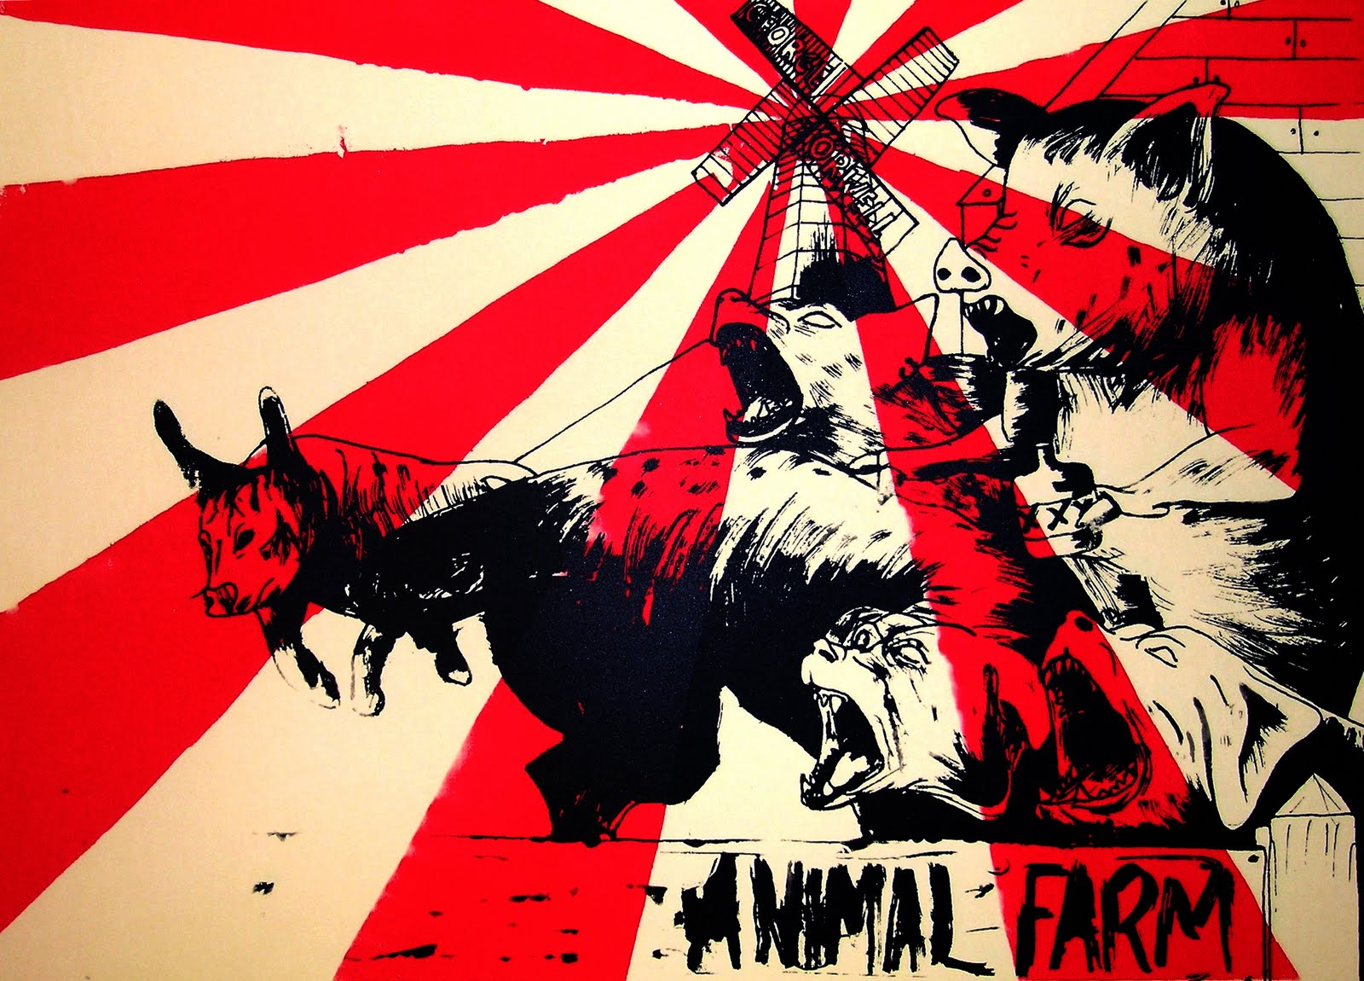
Chapter 5 &6

Slide 10
Group Project
With team, make a list of all the things that have changed on the farm since the animals kicked out Mr. Jones
Rank them in order of importance

Slide 11
Vocabulary
Tone
Mood
Connotation
Inference

Slide 12
Mary Poppins
https://www.bing.com/videos/search?q=mary+poppins+trailer&&view=detail&mid=8E3664F3D281668F7AD88E3664F3D281668F7AD8&&FORM=VRDGAR
Tone
Mood
Connotation
Inference

Slide 13
Scary Mary
https://www.bing.com/videos/search?q=scary+mary+trailer&view=detail&mid=1D0129C97597D1D862C61D0129C97597D1D862C6&FORM=VIRE
Tone
Mood
Connotation
Inference

Slide 14
Freewrite:
What exactly caused the mood to change in “Scary Mary”?

Slide 15
Orwell’s Tone toward Characters
Select the 3 descriptive sentences from chapter 6
Pick out the adjectives that describe characters and places
What is the tone toward these subjects (positive or negative)?

Slide 16
With your team
Rewrite one of the sections in a different tone
Draw a visual (poster) to help us visualize your change

Slide 17
Bell Ringers
Wednesday: What is a literary conflict?
Example?

Slide 18
Bell Ringers
Wednesday: What is a literary conflict?
Character
vs.
Character/society/self/nature
Example? Ms. Kate tries to survive on a deserted island (character vs. nature)

Slide 19
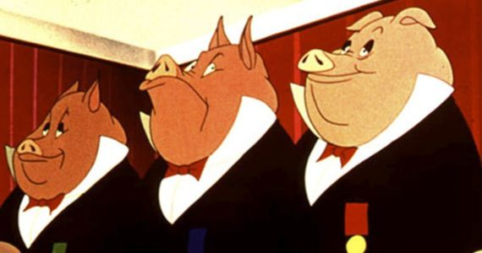
Reading Chapter 7

Slide 20
Mock Trials of Russia
While Reading, interpret article with STEPS 1 - 9

Slide 21
Bell Ringers
Thursday: What is the turning point called/When is the conflict resolved?

Slide 22
Bell Ringers
Thursday: What is the turning point called/When is the conflict resolved?
Answer: Climax

Slide 23
Reading Chapter 8

Slide 24
Chapter Questions
The pigs change the commandments! Is it believable that the animals are fooled by this?
Squealer uses statistics to confuse and convince the animals. How often do people do this? Give an example
Napoleon is a dynamic character. How is he changing? Why?
The humans attack, the animals “win” and the pigs celebrate. How is this against the initial commandments?
How does propaganda influence our decisions and personal development?

Slide 25
Bell Ringers
Friday: What is characterization? Provide 2 types

Slide 26
Bell Ringers
Characterization = character development
2 types = Direct (using adjectives to describe character) and indirect (reading into character actions and statements)

Slide 27
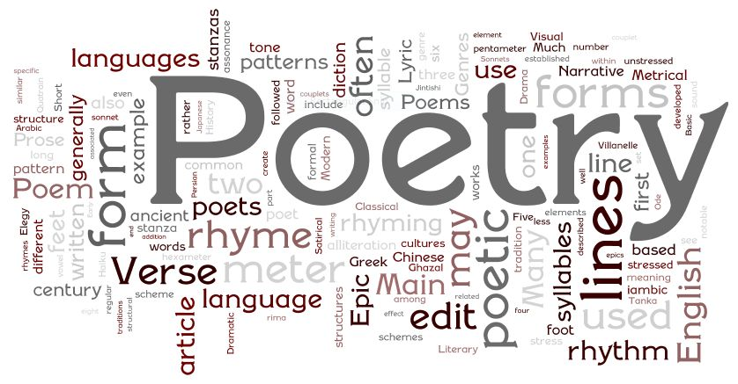
How to Read a Poem Notes

Slide 28
Minimus’ Poem
Go through the steps
Text-Dependent Questions on handout

