Slide 1
Argumentation Week 2
7th Grade Language Arts

Slide 2
Turn to page 42 of your notebook
Answer Monday’s Question
What are 4 things you need for a good argument?

Slide 3
Notes Categories of evidence (p. 43)
Copy Ms. Kate’s prompts

Slide 4
1.) What is ethos?
Building trust and persuading your reader with credible sources (like experts, facts from scientific studies)

Slide 5
2.) What is pathos?
Persuading your reader with feelings and emotions. Often this is done with communicating personal anecdotes (stories) and appealing to readers’ moral beliefs.

Slide 6
3. What is logos?
Using common sense to appeal to someone’s rational, reasonable, and logical conclusions (statistics)

Slide 7
4. Why do we use ethos pathos and logos
To Persuade readers and viewers

Slide 8
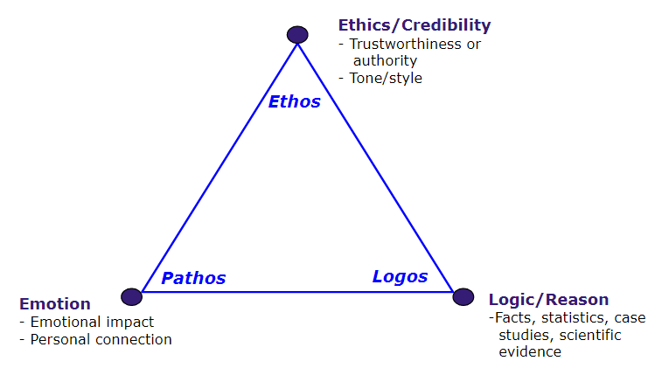

Slide 9
5. Matching types of evidence to the rhetorical triangle
Label each side ethos, pathos, and logos
Get out each little square from the plastic sleeve and match each type of evidence with ethos, pathos, and logos

Slide 10
Argumentation in the media (p. 44)
Genre: Media
Title: “The Early Show – Are Energy Drinks Bad for You?”
Author: CBS News
Author’s Claim
Reasons Given:
Evidence: Draw the Rhetorical Triangle
Examples of ethos, pathos, and logos in the video clip
7. What is the counterclaim to CBS’s argument?

Slide 11
Argumentation in Nonficiton (p. 45)
Genre: Nonfiction
Title: “A Drinking Problem”
Author:
Author’s Claim
Reasons Given:
Evidence: Draw the Rhetorical Triangle
Examples of ethos, pathos, and logos in the video clip
7. What is the counterclaim to CBS’s argument?

Slide 12
Argumentation in the media (p. 46)
Genre: Media
Title: “
Author:
Author’s Claim
Reasons Given:
Evidence: Draw the Rhetorical Triangle
Examples of ethos, pathos, and logos in the video clip
7. What is the counterclaim to CBS’s argument?

Slide 13
Argumentation in the Nonfiction (p. 47)
Genre: Media
Title: “
Author:
Author’s Claim
Reasons Given:
Evidence: Draw the Rhetorical Triangle
Examples of ethos, pathos, and logos in the video clip
7. What is the counterclaim to CBS’s argument?

Slide 14
Evidence Matching (p. 48)
There are 2 claims to sort evidence into
Claim 1: Energy drinks are bad for youth
Claim 2: Energy drinks are misjudged

Slide 15
Annotating the writing Prompt (p. 49)
Pull from all our sources and decide what you believe. Should energy drinks be prohibited to people under the age of 18? Defend your claim and reasoning with evidence. Convince people to believe you and change their attitudes toward energy drinks.
Do: What:
Pull From this week’s sources
Decide What you believe about energy drinks
Defend Your claim and reasoning with evidence
Convince People to believe you and change

Slide 16
Stating Your position (p. 50)
Here are some sentence stems to get you started
The author of “A Drinking Problem” argues that…………….
2. The author of “Quenched” disagrees by saying……..
3. I believe energy drinks are……….because…………….. (this is your claim and reasoning – also knowln as a thesis).

Slide 17
Create a rhetorical triangle
Ethos Evidence to support your view
Pathos Evidence to support your view
Logos Evidence to support your view

Slide 18
Interview with peers
Interview the counterclaim
Create a rhetorical triangle to map our your enemy’s evidence

