Slide 1
Freewrite: What is figurative language? Define and Come up with 3 examples

Slide 2
Figurative Language
Figurative (or non-literal) language uses words deviating from their proper definitions in order to achieve a more complicated understanding or heightened effect. Figurative language is often achieved by presenting words in order for them to be equated, compared, or associated with other normally unrelated words or meanings.

Slide 3
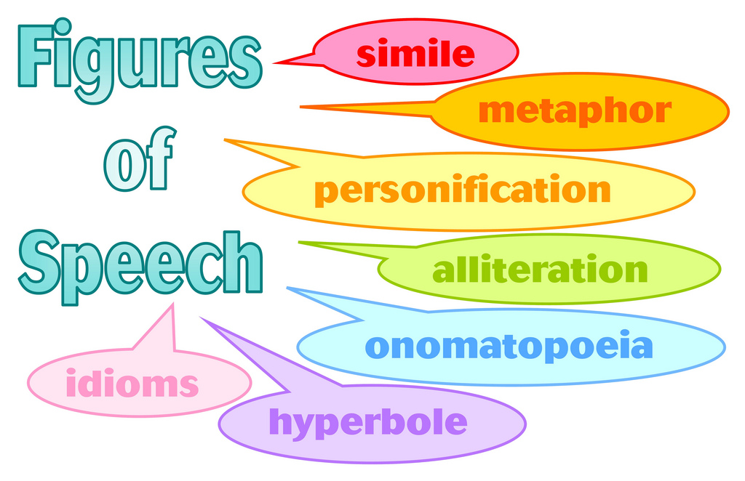
Pretest

Slide 4
Warm-Up: Vocabulary
Define it your own way
Use it in a new sentence
Illustrate the new word

Slide 5
Aghhhh We have a mystery

Slide 6
Who did it?
There has been a terrible crime in the city of Troy! The city has been destroyed by a “firebrand.”
Each person, in your team of archeologists, has uncovered a piece of evidence (on your desk in plastic coverings). Interpret your evidence with the close read questions and share evidence with your group. ANSWER THE CLOSE READ QUESTIONS ON YOUR POST-IT NOTES – STICK THEM TO THE PLASTIC COVERING
Together, make a list of possible character connections and make a prediction about what YOU THINK happened in Troy.

Slide 7
Freewrite
View the evidence. What point of view is the story told from?

Slide 8
Group Member #1.) The Wedding Feast
IN THE HIGH and far-off days when men were heroes and walked with the gods, Peleus, king of the Myrmidons, took for his wife a sea nymph called Thetis, Thetis of the Silver Feet. Many guests came to their wedding feast, and among the mortal guests came all the gods of high Olympus. But as they sat feasting, one who had not been invited was suddenly in their midst: Eris, the goddess of discord. Yet here she was, all the same, and in her blackest mood, to avenge the insult.
All she did—it seemed a small thing—was to toss down on the table a golden apple. Then she breathed upon the guests once, and vanished.
Why was Eris left out?
Why would Eris give them, the goddesses/gods who left her out, a golden apple?
What does an apple symbolize?
How might the message have been different if it were another fruit?
Since Eris is the goddess of discord, what do you predict will happen to the gods of high Olympus? What will happen in the mortal world as a result?

Slide 9
Group Member #2.) The Golden Apple
The apple lay gleaming among the piled fruits and the brimming wine cups; and bending close to look at it, everyone could see the words “To the fairest” traced on its side.
Then the three greatest of the goddesses each claimed that it was hers. Hera claimed it as wife to Zeus, the All-father, and queen of all the gods. Athene claimed that she had the better right, for the beauty of wisdom such as hers surpassed all else. Aphrodite only smiled, and asked who had a better claim to beauty’s prize than the goddess of beauty herself.
They fell to arguing among themselves; the argument became a quarrel, and the quarrel grew more and more bitter, and each called upon the assembled guests to judge between them. But the other guests refused, for they knew well enough that, whichever goddess they chose to receive the golden apple, they would make enemies of the other two.
Who is involved in the Golden Apple?
What other folktales does this Apple story remind you of?
What does an apple symbolize?
What does gold symbolize?
Why do these all-powerful goddesses want a golden apple?
Who do you think will be the fairest?

Slide 10
Group Member #3.) Son of Troy
Now on the northeast coast of the Aegean Sea, there was a city of men. Troy was its name, a great city surrounded by strong walls, and standing on a hill hard by the shore. It had grown rich on the tolls that its kings demanded from merchant ships passing up the nearby straits to the Black Sea cornlands and down again. Priam, who was now king, was lord of wide realms and long-maned horses, and he had many sons about his hearth. And when the quarrel about the golden apple was still raw and new, a last son was born to him and his wife Queen Hecuba, and they called him Paris.
There should have been great rejoicing, but while Hecuba still carried the babe within her, the soothsayers had foretold that she would give birth to a firebrand that should burn down Troy. And so, when he was born and named, the king bade a servant carry him out into the wilderness and leave him to die. The servant did as he was bid; but a herdsman searching for a missing calf found the babe and brought him up as his own.
What is a soothsayer?
What did they foretell?
Do you think this was a good reason to leave a baby in the wilderness to die?
What does this tell you about the Ancient world?
What would you have done if you found a baby in the wilderness?

Slide 11
Group Member #4.) The Contest
Among the oak woods they lived together and were happy—until one day the three jealous goddesses, still quarreling about the golden apple, chanced to look down from Olympus, and saw the beautiful young man herding his cattle on the slopes of Mount Ida. They knew, for the gods know all things, that he was the son of Priam, king of Troy, though he himself did not know it yet; but the thought came to them that he would not know who they were, and therefore he would not be afraid to judge between them. They were growing somewhat weary of the argument by then.
So they tossed the apple down to him, and Paris put up his hands and caught it. After it the three came down, landing before him so lightly that their feet did not bend the mountain grasses, and bade him choose between them, which was the fairest and had best right to the prize he held in his hand.
First Athene, in her gleaming armor, fixed him with sword-gray eyes and promised him supreme wisdom if he would name her.
Then Hera, in her royal robes as queen of heaven, promised him vast wealth and power and honor if he awarded her the prize.
Lastly, Aphrodite drew near, her eyes as blue as deep-sea water, her hair like spun gold wreathed around her head, and, smiling honey-sweet, whispered that she would give him a wife as fair as herself if he tossed the apple to her.
And Paris forgot the other two with their offers of wisdom and power, forgot also, for that moment, dark-haired Oenone, in the shadowed oak woods; and he gave the golden apple to Aphrodite.
Then Athene and Hera were angry with him for refusing them the prize, just as the wedding guests had known that they would be; and both of them were angry with Aphrodite. But Aphrodite was well content, and set about keeping her promise to the herdsman who was a king’s son.
Do you think that Paris made the right decision?
What would you have done?
What do you think Aphrodite will do?
How will Athene and Hera react to Paris’ choice?

Slide 12
Group Member #5.) The Legendary Beauty
Even beyond the farthest bounds of Greece, the fame of Helen’s beauty traveled, until it came at last to Troy, as Aphrodite had known that it would. And Paris no sooner heard of her than he determined to go and see for himself if she was indeed as fair as men said. Oenone wept and begged him to stay with her; but he paid no heed, and his feet came no more up the track to her woodland cave. If Paris wanted a thing, then he must have it; so he begged a ship from his father, and he and his companions set out.
Slaves met them, as they met all strangers, in the outer court, and led them in to wash off the salt and the dust of the long journey. And presently, clad in fresh clothes, they where standing before the king in his great hall, where the fire burned on the raised hearth in the center and the king’s favorite hounds lay sprawled about his feet.
“Welcome to you, strangers,” said Menelaus. “Tell me now who you are and where you come from, and what brings you to my hall.”
“I am a king’s son, Paris by name, from Troy, far across the sea,” Paris told him. “And I come because the wish is on me to see distant places, and the fame of Menelaus has reached our shores, as a great king and a generous host to strangers.”
“Sit then, and eat, for you must be way-weary with such far traveling,” said the king.
And when they were seated, meat and fruit, and wine in golden cups were brought in and set before them. And while they ate and talked with their host, telling the adventures of their journey, Helen the queen came in from the women’s quarters, two of her maidens following, one carrying her baby daughter, one carrying her ivory spindle and distaff laden with wool of the deepest violet color. And she sat down on the ar side of the fire, the women’s side, and began to spin. And as she spun, she listened to the stranger’s tales of his journeying.

Slide 13
And in little snatched glances their eyes went to each other through the fronding hearth-smoke. And Paris saw that Menelaus’ queen was fairer even than the stories told, with hair golden as a corn-stalk and sweet as wild honey. And Helen saw, above all things, that the stranger prince was young. Menelaus had been her father’s choice, not hers, and though their marriage was happy enough, he was much older than she was, with the first gray hairs already in his beard. There was no gray in the gold of Paris’ beard, and his eyes were bright and there was laughter at the corners of his mouth. Her heart quickened as she looked at him, and once, still spinning, she snapped the violet thread.
For many days Paris and his companions remained the guests of King Menelaus, and soon it was not enough for Paris to look at the queen. Poor Oenone was quite forgotten, and he did not know how to go away leaving Helen of the Fair Cheeks behind.
So the days went by, and the prince and the queen walked together through the cool olive gardens and under the white-flowered almond trees of the palace; and he sat at her feet while she spun her violet wool, and sang her the songs of his own people.
Summarize Helen’s life – what has happened to her and how would you feel if you were her?
What forms of figurative language are used to describe Helen? What does this say about her?
What are Paris’ intentions toward Helen?
How did Paris lie to Menelaus? And WHY?
Who is Oenone?
What do you predict will happen?

Slide 14
After each person interprets and “talks to” their text sections. The group will receive a “Character Connections” inference chart. They are meant to solve the Mystery of Troy. Who is the firebrand and what happened to Troy? The “Character Connections & Inference” chart is featured below:
Directions: With your team, take each character index card (separated onto index cards) and draw a symbol on the back - to represent the character. Tape them to your poster and connect characters who know each other (with grouping, lines, and symbols).
Queen Helen Aphrodite Hera Eris Zeus
Herdsman Athene Oenone Paris Thetis Pelius
King Priam Odysseus Penelope Queen Hecuba

Slide 15
Exit Ticket
Based off of character connections, and inferences you have made with your group, what do you predict will happen to the characters in Troy? Answer in complete sentences with evidence from 2 team text selections.

Slide 16
Freewrite:
Create a chart of characters from “Black Ships Before Troy”
Characters that Change Characters that don’t change
(Dynamic/Round) (Static/Flat)

Slide 17
Hold Your Thinking
“Black Ships Before Troy”

