Slide 1
October 22, 2018
Language Arts

Slide 2
Leonardo Da Vinci
“Nothing can be loved or hated unless it is first understood”

Slide 3
Daily expectations
We come to class prepared (see materials needed)
Only one of us can go to the bathroom at a time
We may not leave the room more than once
We may not leave our seats without permission
We are kind to each other
Electronics are off and away (unless we ask)
Trash goes in the trashcan and recycling goes in the recycling!!!!!

Slide 4
Independent work expectations
I come class prepared (see materials needed)
I remain focused and quiet
My electronics are off and away (unless I ask)
I will raise my hand if I have a question or comment (I won’t shout at Ms. Kate)
You may not leave your seat without permission
Trash goes in the trashcan and recycling goes in the recycling!!!!!

Slide 5
Group work expectations
We do not talk to other groups
Our electronics are off and away (unless we ask)
We will raise our hands if we have a question or comment (We won’t shout at Ms. Kate)
We stay seated
We fulfill our group roles

Slide 6
What are our group roles?
Prepare to take notes on your graphic organizer
In each of the boxes write or draw a way to remember each role when working in a group

Slide 7
reporter
The reporter’s job is to present the task to the class once it is complete.
More than one person can be the reporter

Slide 8
Recorder
The recorder’s job is to write down information for the group. It is not the job of the recorder to find all the information alone or find all the answers.
The recorder will write down questions and observatitons from the group

Slide 9
Artist
The artists job is to draw anything that needs to be drawn or organize who will be drawing different parts.
The artist can also coordinate a performance or create poetry/music to enrich a presentation.

Slide 10
Leader
The leader’s job is to help all group members get their jobs done or help make decisions for the group. Only one person can be the leader, but the leader can help do other jobs.

Slide 11
Time manager
The job of the time manager is to keep track of how much time is left for the task or how much more time the group needs to complete the task.
The time manager can work together with the leader and recorder to make sure everyone is asking questions and completing their jobs.

Slide 12
Materials manager
The materials manager is responsible for picking up or collecting any materials needed by the group (folders and etc.)
The materials manager is also responsible for asking Ms. Kate for any needed supplies.

Slide 13
Expectations for whole group discussions
We quietly listen to other ideas (even if we don’t agree)
Our electronics are off and away (unless we ask)
We will raise our hands if we have a question or comment (must take turns talking)
We stay seated

Slide 14
Warm up: Survival island

Slide 15
Survival island
Oh no! You have become stuck on a deserted island where there are just palm trees and a freshwater stream. There are no other people, but the good news is you managed to find a giant crate full of items that can help you survive. The bad news is that you only have time to grab 5 of the items before the crate sails away forever. Circle the 5 items you would grab.

Slide 16
Survival Island
Wow! Something amazing has happened! You have run into another castaway. The bad news is a huge tropical storm has washed away some off the items you and your new friend collected. You can only keep 5 items between the two of you. Compare your items and choose 5 to keep. Write them on the lines below.

Slide 17
Survival Island
How did you make your choices? What things did you do to make decisions? Write these ideas on the lines below.

Slide 18
Survival Island
Wow! Something amazing has happened! You and your castaway friend have found another pair of castaways. Now you should have room for 10 items, but the bad news is a giant monkey came in the middle of the night and took some off the items you and your new friends owned. You can only keep 5 items between the group. Compare your items and choose 5 to keep. Write them on the lines.

Slide 19
Survival Island
How did you make your choices? What things did you do to make decisions? Write these ideas on the lines below.

Slide 20
Survival Island
What is the world coming to?! You have been rescued and the world wants to hear your amazing story of survival. Everything you’ve had with you on the island is going to be put in the museum on display as part of an amazing exhibit. Your group discovers they are just tone of many groups found on the island. Now you should have room for lots of items, but the bad news is there is only room on the helicopter for 5...

Slide 21
Survival Island
What are your final 5
How did the whole group make these choices? What things did we do to make decisions? Write these ideas on the lines.

Slide 22
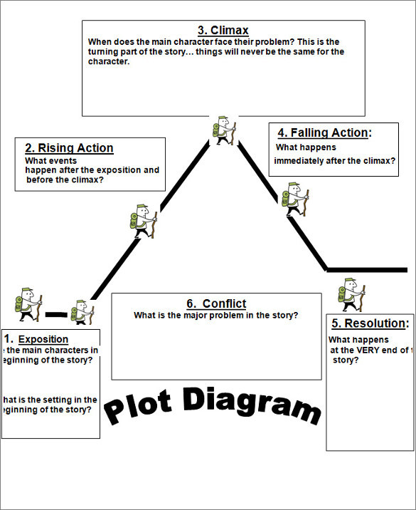
Draw me: Sheep on the island

Slide 23
VOCABULARY PREVIEW FOR BONE bLACK
VOCABULARY TERM
DEFINE IT IN YOUR OWN WORDS
USE THE WORD IN A NEW SENTENCE
ILLUSTRATE THIS NEW SENTENCE

Slide 24
There has been a leak..
Our story…
HAS DRIPPED ONTO YOUR DESKS!
EACH GROUP MEMBER HAS A DIFFERENT PIECE OF THE PUZZLE. WHAT IS THE TOPIC AND THEME?
ANSWER YOUR PIECE’S QUESTIONS WITH A POST-IT

Slide 25
There has been a leak..
Our story…
CAN YOU PUT THE PUZZLE PIECES IN ORDER?

Slide 26
Group Member #1.)
“She was closest to her brother. Not only were they just months apart in age but they looked alike. They looked like twins even though he was older. Like twins they shared the same dreams and longings, the same devotion to one another.”
What point of view is this story told in?
What do you think the topic is?
What do we learn about the topic (what is the theme)?

Slide 27
Group Member #2.)
“Strangely enough it was a toy that separated them, that forced upon them different roles, different identities. She remembered the toy – a bright red wagon. They shared possession of it but they had different roles in relationship to it. She was to ride in the red wagon and he was to pull it.”
What point of view is this story told in?
What do you think the topic is?
What do we learn about the topic (what is the theme)?

Slide 28
Group Member #3.)
“She was to ride in it because she was a girl – a princess whom some rich prince would come seeking, take away to his palace, and keep her there in splendor forever. He was to pull because he was a boy – a would-be prince who would do all the hard work, slay the dragons, fight the slimy creatures, challenge the fat ugly men so that he could carry away the beautiful princess.”
What point of view is this story told in?
What do you think the topic is?
What do we learn about the topic (what is the theme)?

Slide 29
Group Member #4.)
“He would always say, Tell them, knowing all the time that she would not, that she hated to see him punished. If he was punished she would want to be punished, too; even if they would not punish her she would cry with him. Sometimes the father and the great-grandfather would find out that the boy rarely pulled the girl. They would stand towering over him speaking in harsh big voices, explaining that he was the boy and should do this, explaining to him that if he did not do what boys should do they would take the toy away, give it to the girl only, not let them share it. She was always standing in the background listening – waiting to hear the boy tell her when they were alone that he hate, hate, hated her because she was a girl.”
What point of view is this story told in?
What do you think the topic is?
What do we learn about the topic (what is the theme)?

Slide 30
Group Member #5.)
“She grew up not remembering why the red wagon had been so important. She grew up and found that the red wagon of her memory had never existed. “
What point of view is this story told in?
What do you think the topic is? What does a red wagon symbolize?
What do we learn about the topic (what is the theme)?

Slide 31
Character connections
After each person interprets their sections, the group will create a poster showing how your characters are connected
1.) DIRECTIONS: WITH YOUR TEAM, MAKE AN INDEX CARD FOR THE FOLLOWING CHARACTERS
The Girl, The Boy, Papa, Grown-Ups
2.) DRAW A SYMBOL ON THE BACK OF YOUR INDEX CARD (WITH ONE ABSTRACT WORD - TO REPRESENT THE CHARACTER). TAPE EACH INDEX CARD TO YOUR POSTER AND CONNECT THE INDEX CARDS WITH DESCRIPTIONS OF HOW YOUR CHARACTERS GET ALONG.

Slide 32
EXIT TICKET: Post-it
BASED OFF OF YOUR GROUP WORK, WHAT DO YOU PREDICT THE TOPIC AND THEME WILL BE? ANSWER IN COMPLETE SENTENCES

