Slide 1
Protest poetry and social justice project
7th Grade Language Arts

Slide 2
Bellringer
TCAP Practice
Practice annotating writing prompts

Slide 3
New Unit
We are preparing to take our final exams – so each warm up will help you practice your test taking skills
We are finishing up our unit on fairness and development and will work towards using our knowledge of persuasion and figurative language to create social change. We are building our identities as leaders and we will create works of poetry, narratives, expository texts, and argumentative texts.

Slide 4
Guided notes: How to read a poem

Slide 5
Number your notebook pages

Slide 6
#1 Poverty/Hunger/unemployment

Slide 7
#2 Climate Change/Pollution

Slide 8
#3 War and violence

Slide 9
#4 Immigration practices

Slide 10
#5 Civil Rights Violations

Slide 11
#6 Crime/justice system

Slide 12
Define and use the following words in a cohesive paragraph
Rebel
Protest
Power
Demonstrator
Uprising
Rebellion

Slide 13
What Gandhi can teach today’s protestors?
Guided annotations as we read
Deconstructing the author’s structure

Slide 14
Select an issue
Poverty
Climate Change/Pollution
Civil Rights Violations
War
Immigration Practices
Criminal Justice System

Slide 15
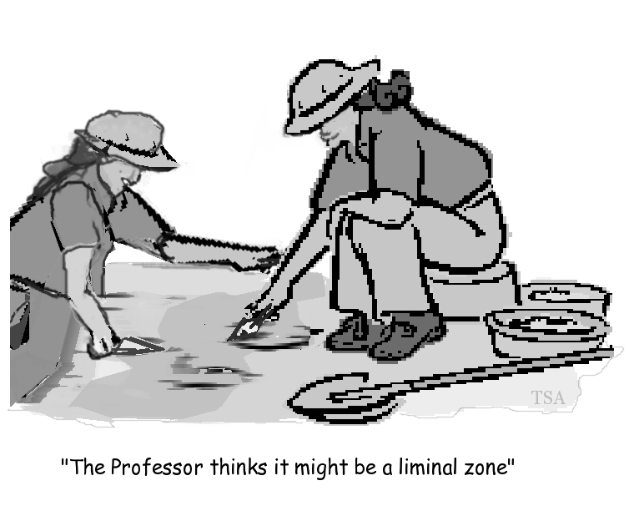
Primary Source Annotations

Slide 16
Mapping The Issue

Slide 17
Modality Stations – ADVANCED FINAL PROJECT
Kinesthetic
Create a simulation of how your social justice issue could be solved
Musical
You are part of the new protest song movement. Pick a social justice issue and a piece of instrumental music and write your own protest lyrics to accompany it.
Spatial
Frozen Tableau
Create a “map collage” of where your social justice issue started
Visual
Create a comic or work of art that advertises the importance of your chosen issue and what could solve it

