Slide 1
Protest poetry and social justice project
7th Grade Language Arts

Slide 2
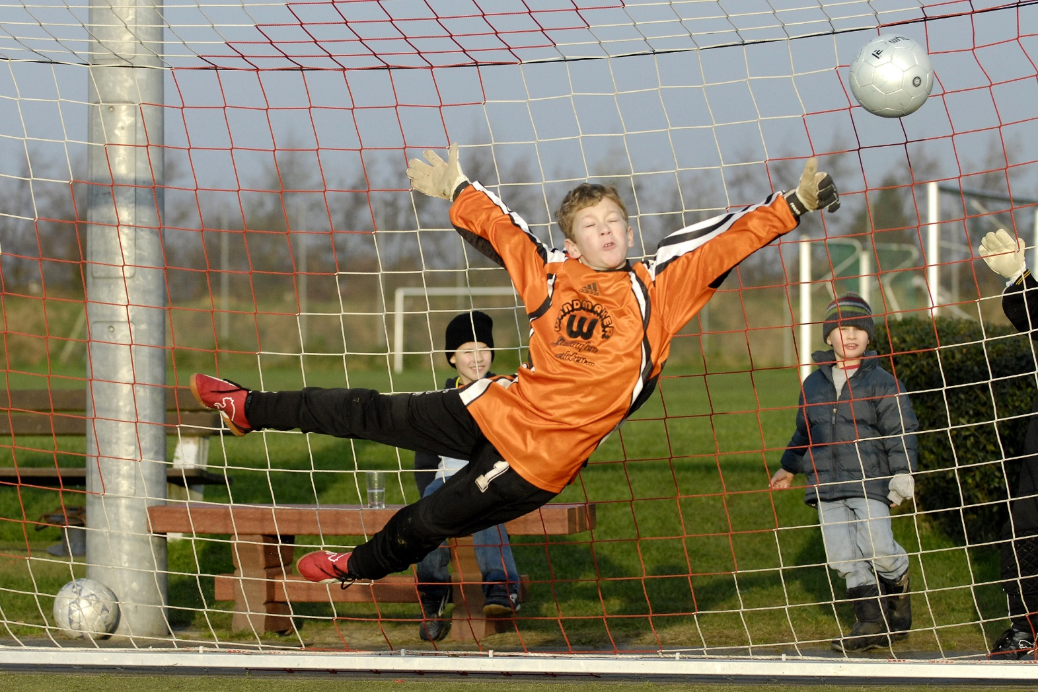
Bellringer: Welcome to Tangerine

Slide 3
New Unit
We are preparing to take our final exams – so each warm up will help you practice your test taking skills
We are finishing up our unit on fairness and development and will work towards using our knowledge of persuasion and figurative language to create social change. We are building our identities as leaders and we will create works of poetry, narratives, expository texts, and argumentative texts.

Slide 4
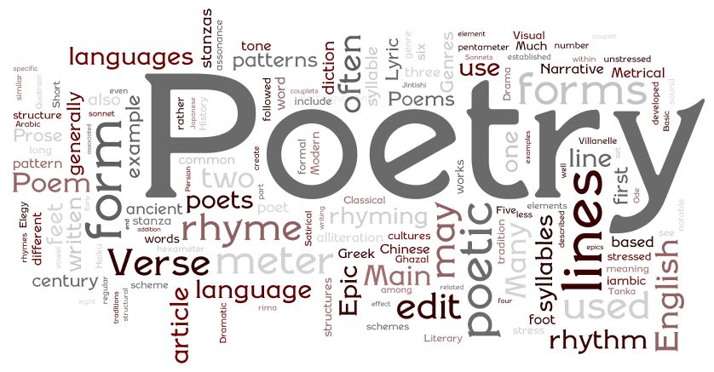
Guided notes: How to read a poem

Slide 5
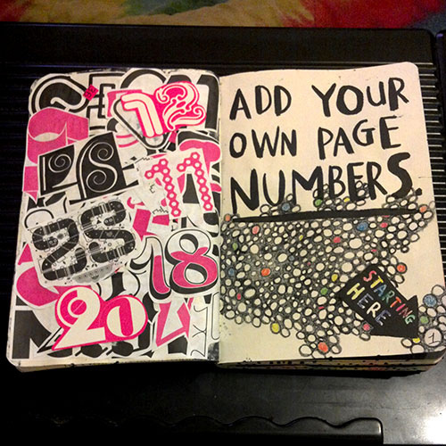
Number your notebook pages

Slide 6
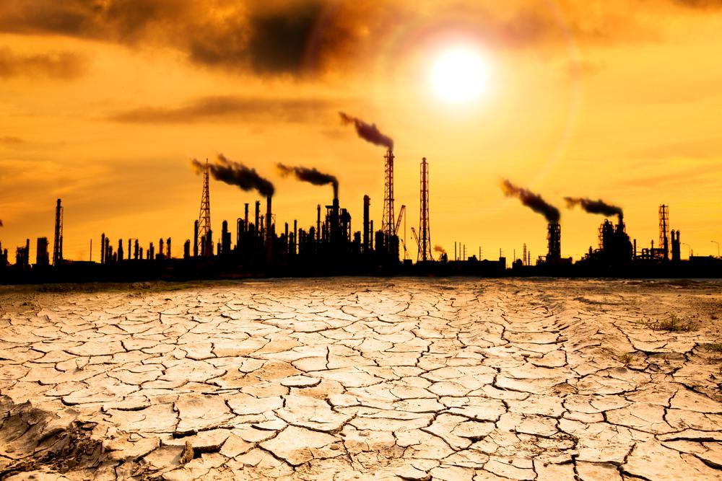
Climate Change/Pollution Project

Slide 7
Climate Change
Research questions
Create a comic

Slide 8
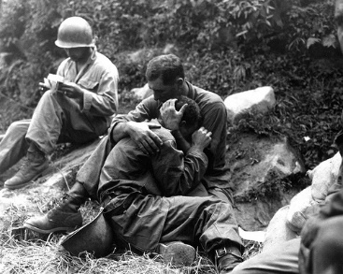
#3 War and violence

Slide 9
War
Research art, music, nonfiction, and fiction that depicts anti-war movements
Explore whether antiwar sentiment empowers or weakens a nation

Slide 10
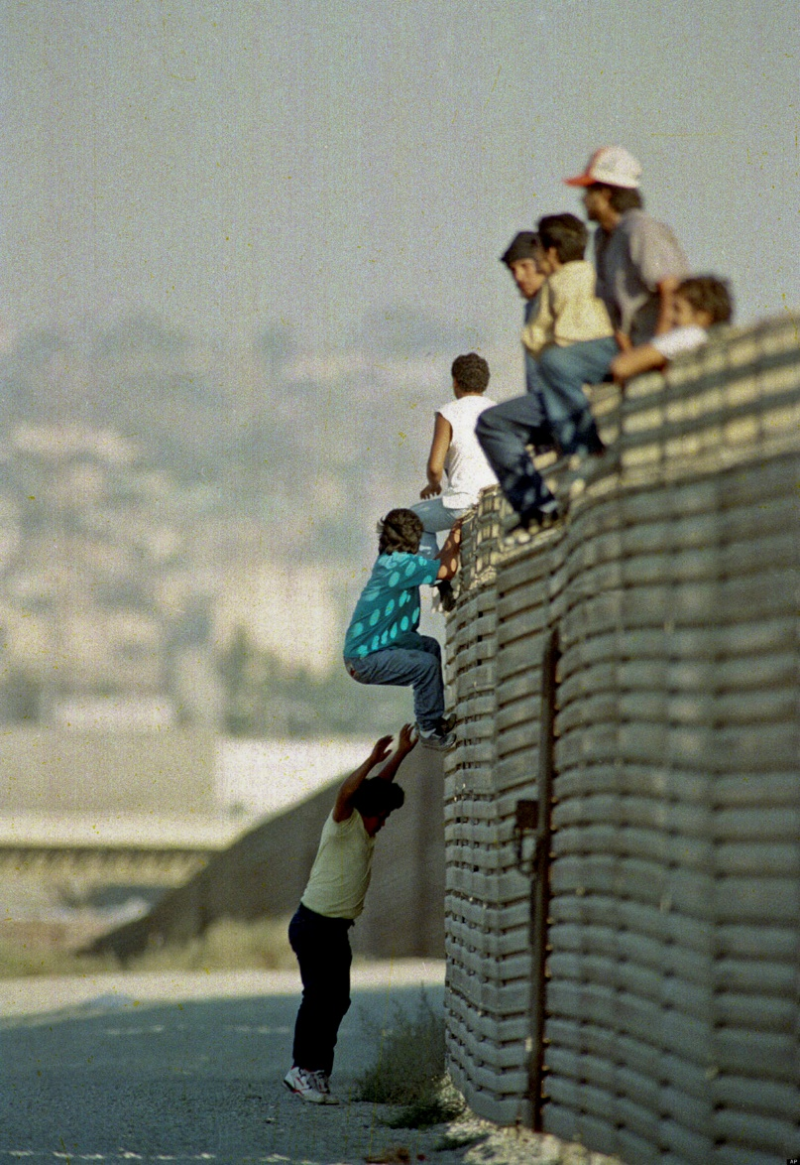
#4 Immigration practices

Slide 11
Immigration Project
Students analyze the differences in American immigration from the 1900s to now. The project culminates in a research presentation of students’ choice.

Slide 12
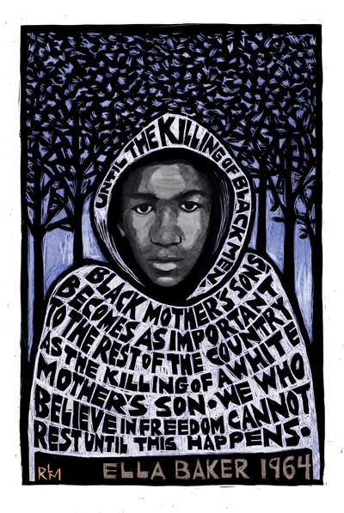
#5 Civil Rights
Violations

Slide 13
Civil Rights Project
Interpret primary sources from the Civil Rights Movement and the Black Lives Matter Movement.
Compare and contrast the movements

