Slide 1
Bellringers: Glue into page 34
Check out our daily warm-up activities
Complete “Tuesday’s Warm-Up Task”
What is the difference between an argument with a friend and an academic argument??

Slide 2
Pretest ~ What do you already Know?

Slide 3
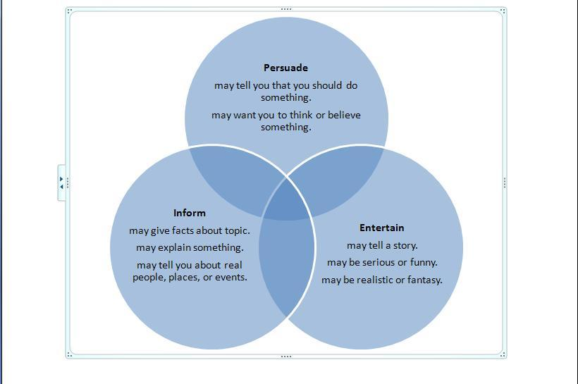
Author’s Purpose notes glue into interactive notebook p. 35

Slide 4
What’s the difference?
Page 35
What’s the difference between Expository (informative) writing and Argumentative (persuasive) writing?

Slide 5
Guided Practice p. 36
Your table has samples of both expository (informative), argumentative (persuasive) writing, and entertaining writing.
You need to separate them into the appropriate categories.

Slide 6
Bellringers: Page 34
Check out our daily warm-up activities
Complete “Wednesday’s Warm-Up Task”
What is the difference between expository writing and argumentative writing?

Slide 7
Argumentation: Glue to page 37
Elements of an Argument Notes

Slide 8
Different Types of Evidence P. 38
Glue in “Types of Evidence” notes
Get together with your team and try to match the examples of evidence with the right category
First group to get all their evidence matched gets 10 points!

Slide 9
A Drinking Problem vs. Quenched
Argumentation Annotations with an argumentative article
Should energy drinks be outlawed to children under 18?
Read both articles with your team

Slide 10
Argumentation Annotations
Instructions: On page 39, glue in
~ “Deconstruct the Essays”
~ “Feeling Stuck?”
Follow all the directions on page 39

Slide 11
Evidence Study
Instructions: Using your annotations, analyze both authors’ evidence with …
“Using Stories, Statistics and Star Statements to Persuade”

Slide 12
Argument Thinking Map P. 40
Instructions: On page 40, glue in
“Organize Your Argument” for “A Drinking Problem”

Slide 13
Argument Thinking Map P. 41
Instructions: On page 41, glue in
“Organize Your Argument” for “Quenched”

Slide 14
Bellringers: Page 34
Check out our daily warm-up activities
Complete “Thursday’s Warm-Up Task”
Was there a time you read an article (or watched a speech) and you were convinced to change? How did the person persuade you?

Slide 15
Bellringers: Page 34
Check out our daily warm-up activities
Complete “Friday’s Warm-Up Task”
What are different types of evidence debators use?

